Slide 1
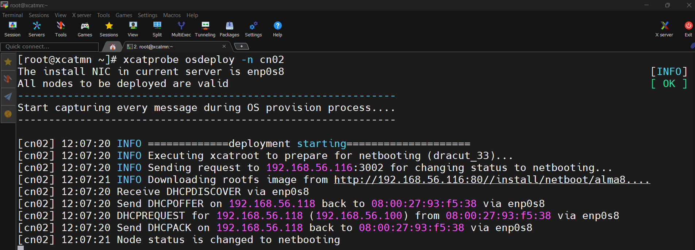
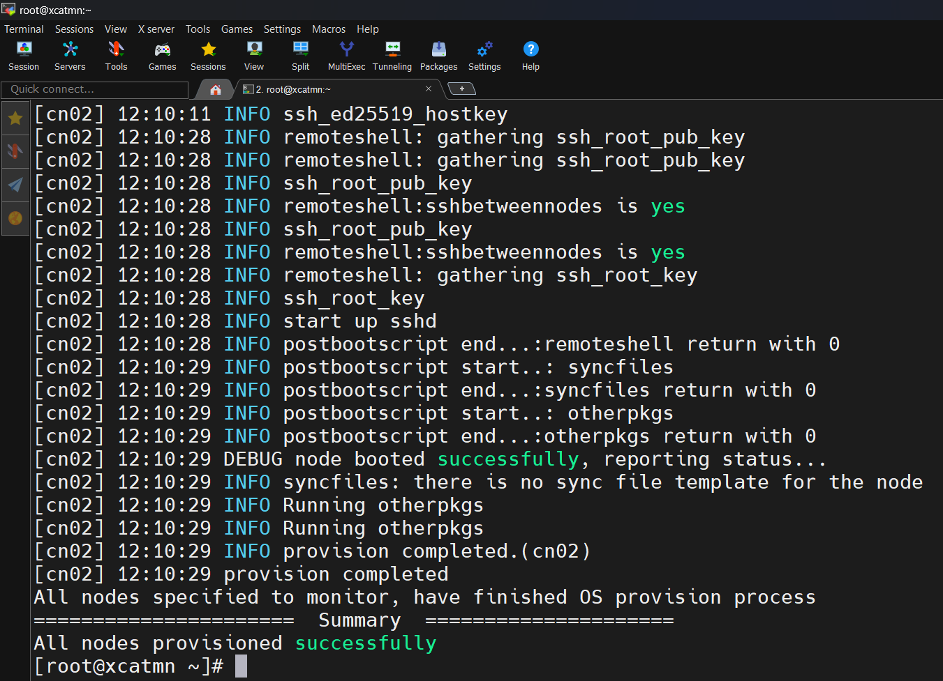
Provisioning Compute Nodes with xCAT
This presentation outlines the steps for provisioning compute nodes. We will cover initial setup, network configuration, and OS deployment. Let's get started configuring your xCAT environment!
PB
- Pravin Bhosale

Slide 2
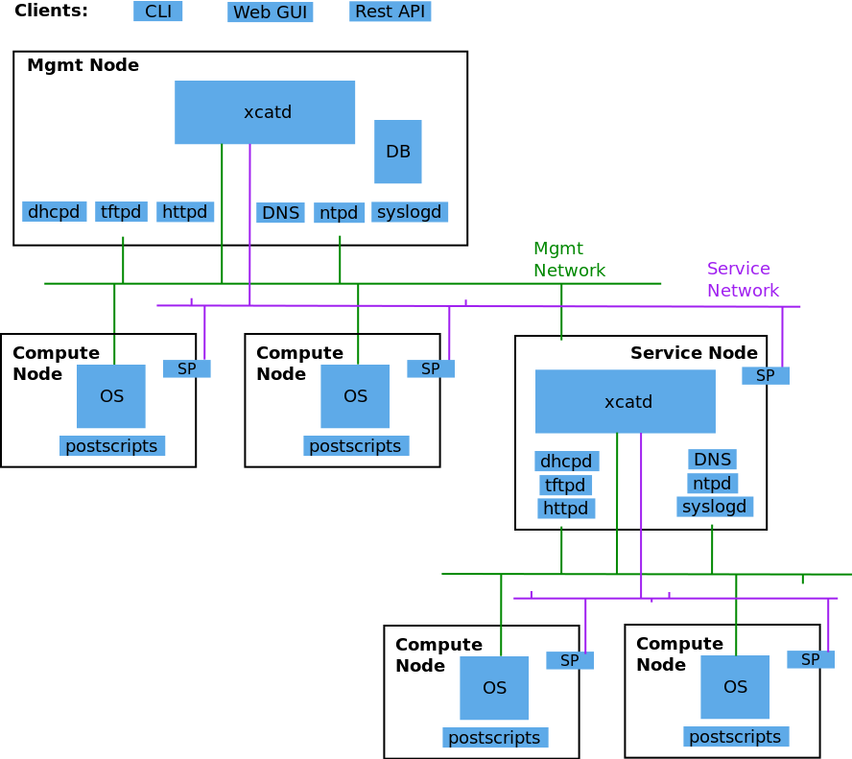
xCAT Architecture

Slide 3
Initial Hostname and Network Setup
Set Hostname
Configure Network
DNS Resolution
Set the hostname on the management node.
Modify network configuration files.
Update DNS settings in /etc/resolv.conf.
sudo vim /etc/sysconfig/network-scripts/ifcfg-ens192
sudo hostnamectl set-hostname xcatmn.cluster.com
search localdomain cluster.com
nameserver 8.8.8.8
nameserver 192.168.56.116

Slide 4

Installing the go-xCAT Tool
Download go-xCAT
Download the go-xCAT tool using wget.
wget https://raw.githubusercontent.com/xcat2/xcat-core/master/xCAT-server/share/xcat/tools/go-xcat -O - >/tmp/go-xcat
Set execute Permissions
Next, change permission to make it executeable.
chmod +x /tmp/go-xcat
Run go-xCAT
Run the go-xCAT tool to install xCAT.
/tmp/go-xcat install

Slide 5

Disabling SELinux
Disable SELinux
SELinux must be disabled to avoid conflicts.
echo 0 > /sys/fs/selinux/enforce
Persist Change
Make the change permanent in /etc/selinux/config.
sed -i 's/^SELINUX=.\*/SELINUX=disabled/' /etc/selinux/config

Slide 6



Configuring Root Password and Network
Set Root Password
Configure the system password for root user.
chtab key=system passwd.username=root passwd.password=root
Define Network
Define the network for DHCP.
chdef -t network 192_168_56_0-255_255_255_0 dynamicrange=192.168.56.150-192.168.56.200

Slide 7
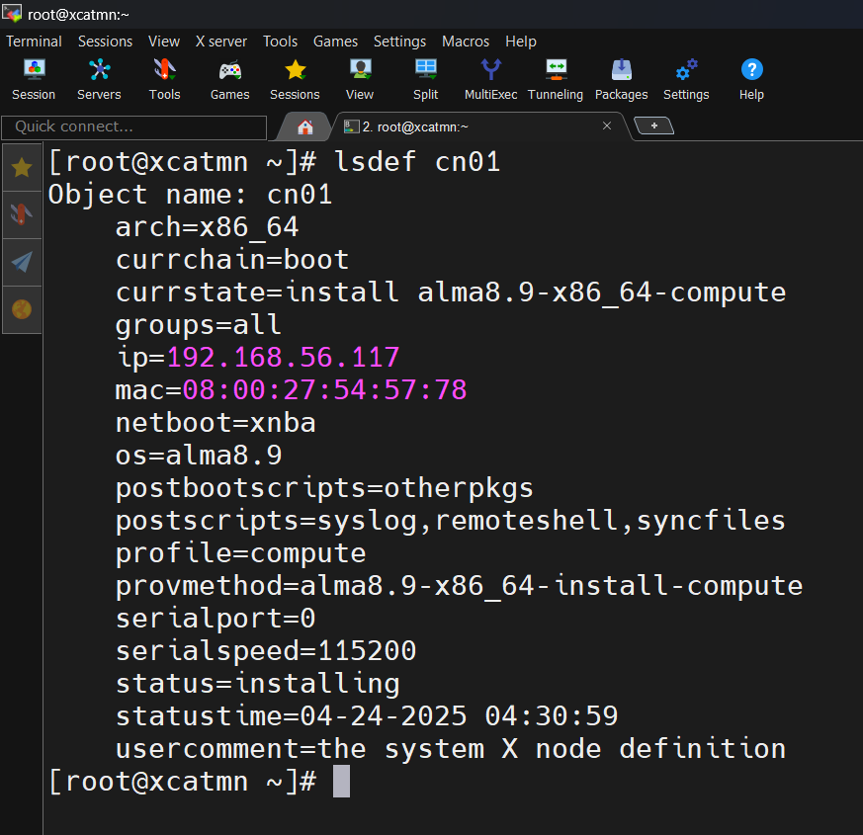
Defining Compute Nodes
Define cn01
Define the first compute node.
mkdef -t node cn01 --template x86_64-template ip=192.168.56.150 mac=08:00:27:54:57:78
Define cn02
Define the second compute node.
mkdef -t node cn02 --template x86_64-template ip=192.168.56.201 mac=08:00:27:93:f5:38

Slide 8





Configure DNS and DHCP
Define DNS Domain
Make Hosts
Make DNS
Configure DHCP
Update host files.
Create DNS entries.
Configure DHCP settings.
Configure the DNS domain.
makehosts cn01
makedns -n
makedhcp -n
chtab key=domain site.value=cluster.com

Slide 9
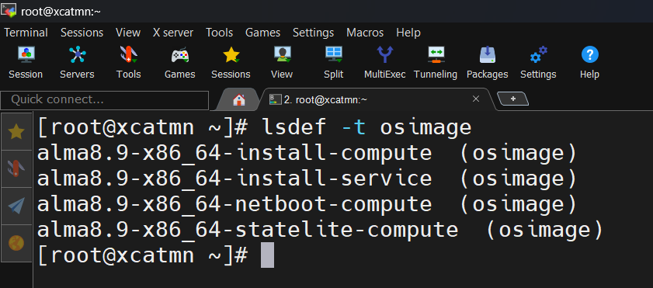

Mounting ISO and Copying Contents
Mount ISO
Copy Contents
Mount the OS installation ISO.
Create a yum repo for the mounted ISO.
mkdir -p /mnt/iso/alma8.10
mount -o loop /tmp/AlmaLinux-8.10-x86_64-dvd.iso /mnt/iso/alma8.10
copycds ~/AlmaLinux-8.10-x86_64-dvd.iso
Final Steps
set the node image and apply all settings.
lsdef -t osimage
nodeset cn01 osimage=alma8.10-x86_64-install-compute

Slide 12
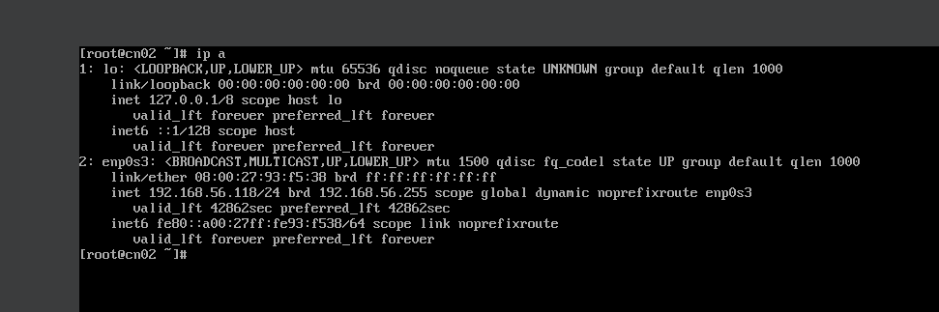

Slide 13
Thank You

